Slide 1


Electric Circuits
Twelfth Edition, Global Edition
Chapter 6 – Part 2
Inductance, Capacitance, and Mutual Inductance
© 2024 Pearson Education Ltd. All Rights Reserved.
Notes:
If this PowerPoint presentation contains mathematical equations, you may need to check that your computer has the following installed:
1) Math Type Plugin
2) Math Player (free versions available)
3) NVDA Reader (free versions available)

Slide 2
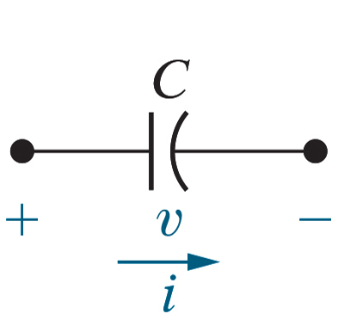
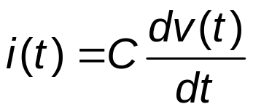
Chapter 6 – Capacitors (1 of 16)
Parallel plates, separated by an insulator, so no charge flows between the plates. Impose a time-varying voltage drop:
  time-varying electric field
  time-varying displacement current
Capacitor equation:
Units: v(t) is volts, i(t) is amps, and C is farads [F]

Slide 3
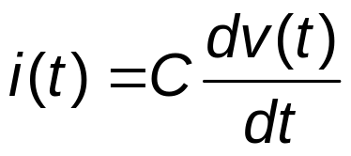

Chapter 6 – Capacitors (2 of 16)
Look at the capacitor equation again:
Suppose v(t) is constant. Then i(t) =
A. 0
B.
C. a constant

Slide 4


Chapter 6 – Capacitors (2 of 16)
Look at the capacitor equation again:
Suppose v(t) is constant. Then i(t) =
A. 0
B.
C. a constant

Slide 5
Chapter 6 – Capacitors (3 of 16)
So, if the voltage drop across the capacitor is constant, its current is 0, so the capacitor can be replaced by
A. a short circuit
B. an open circuit
C. a constant

Slide 6
Chapter 6 – Capacitors (3 of 16)
So, if the voltage drop across the capacitor is constant, its current is 0, so the capacitor can be replaced by
A. a short circuit
B. an open circuit
C. a constant

Slide 7
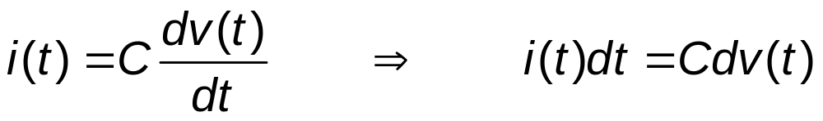
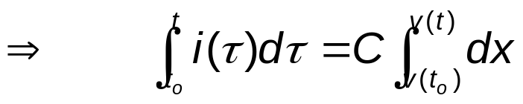
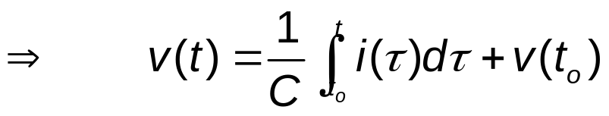
Chapter 6 – Capacitors (6 of 16)
The equation for voltage in terms of current:

Slide 8
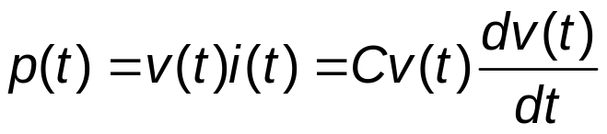
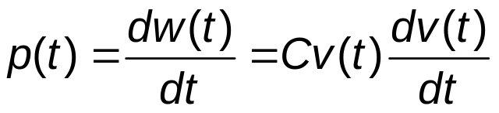

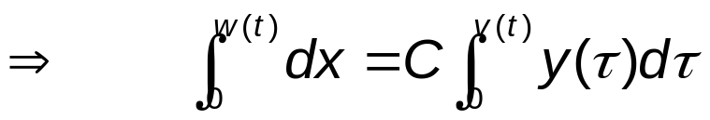

Chapter 6 – Capacitors (7 of 16)
Power and energy

Slide 9
Chapter 6 – Capacitors (8 of 16)
Capacitors, like inductors, are energy storage devices!
  If the initial voltage drop across the capacitor is non-zero, the capacitor is storing energy.

Slide 10




Chapter 6 – Capacitors (9 of 16)
Suppose the initial voltage drop across a
capacitor is
10 V. The initial energy stored in the capacitor is
A.
B.
C.

Slide 11
Chapter 6 – Capacitors (9 of 16)
Suppose the initial voltage drop across a
capacitor is
10 V. The initial energy stored in the capacitor is
A.
B.
C.

Slide 12
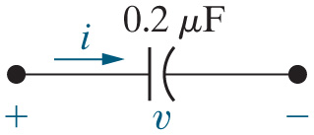
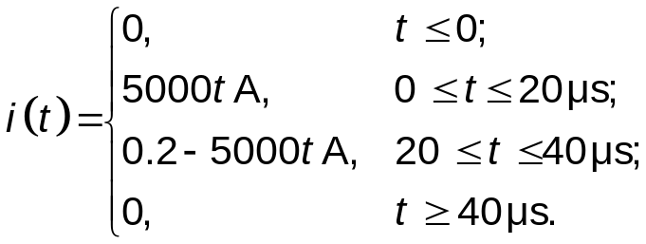





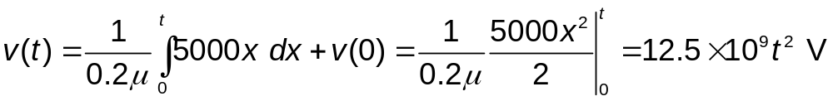


Chapter 6 – Capacitors (10 of 16)
Example – Find the voltage, power, and energy
For
For
At
Notes:
Long Description 1:
i (t) equals Open CurlyBracket.
Line 1: 0, t less than or equal to 0;
Line 2: 5000, t Amperes comma 0 less than or equal to t less than or equal to 20 micro seconds;
Line 3: 0.2 minus 5000 t Ampere, 20 less than or equal to t less than or equal to 40 micro seconds;
0, t greater than or equal to 40 micro seconds.
Long Description 2:
v (t) equals Start Fraction 1 over 0.2 mu End Fraction Integral lower limit 0 upper limit t baseline 5000 x d x plus v (0) equals Start Fraction 1 over 0.2 mu End Fraction Start Fraction 5000 x squared over 2 End Fraction vertical bar lower limit 0 upper limit t baseline equals 12.5 times 10 to the 9 power t squared Volts.

Slide 13
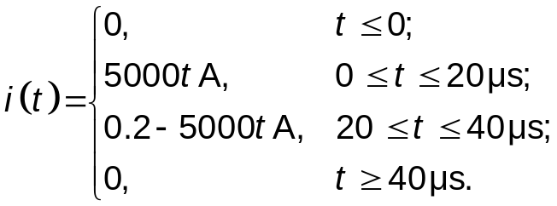

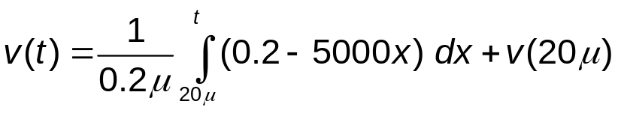
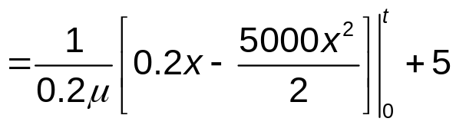




Chapter 6 – Capacitors (11 of 16)
Example (continued)
For
At
Notes:
Long Description:
i (t) equals Open CurlyBracket.
Line 1: 0, t less than or equal to 0;
Line 2: 5000, t Amperes comma 0 less than or equal to t less than or equal to 20 micro seconds;
Line 3: 0.2 minus 5000 t Ampere, 20 less than or equal to t less than or equal to 40 micro seconds;
0, t greater than or equal to 40 micro seconds.

Slide 14
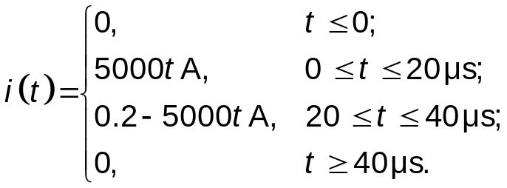

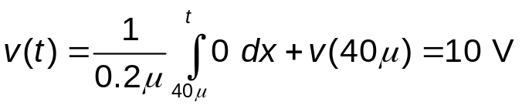



Chapter 6 – Capacitors (12 of 16)
Example (continued)
For
During the interval between 0 and
the power is
positive (absorbed), energy is stored and “trapped” by the capacitor, so even when the current goes to 0, the voltage stays at 10 V and the energy is non-zero.
Notes:
Long Description:
i (t) equals Open CurlyBracket.
Line 1: 0, t less than or equal to 0;
Line 2: 5000, t Amperes comma 0 less than or equal to t less than or equal to 20 micro seconds;
Line 3: 0.2 minus 5000 t Ampere, 20 less than or equal to t less than or equal to 40 micro seconds;
0, t greater than or equal to 40 micro seconds.

Slide 15
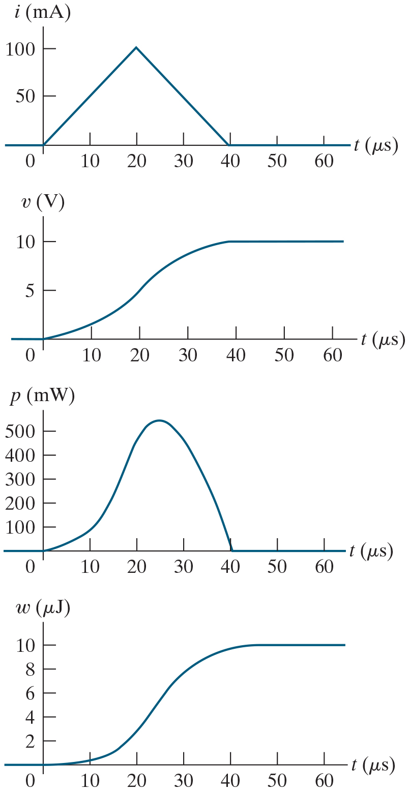
Chapter 6 – Capacitors (13 of 16)
Example (continued)

Slide 16
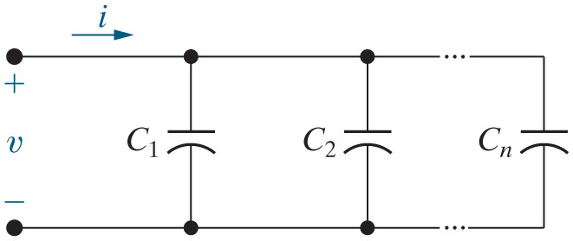
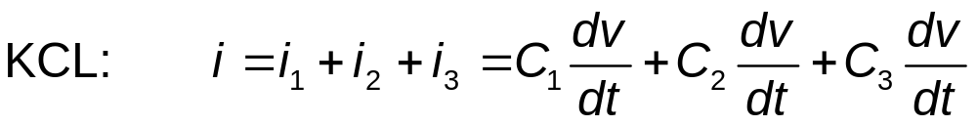
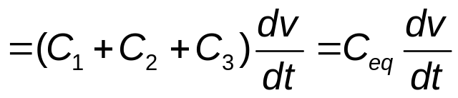
Chapter 6 – Capacitors (14 of 16)
Capacitors in series
Capacitors in parallel A D D.
Notes:
Long Description:
K C L colon i equals i subscript 1 baseline plus i subscript 2 baseline plus i subscript 3 baseline equals C subscript 1 baseline Start Fraction d v over d t End Fraction plus C subscript 2 baseline Start Fraction d v over d t End Fraction plus C subscript 3 baseline Start Fraction d v over d t End Fraction.

Slide 17
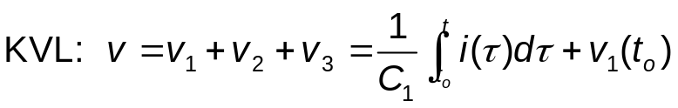
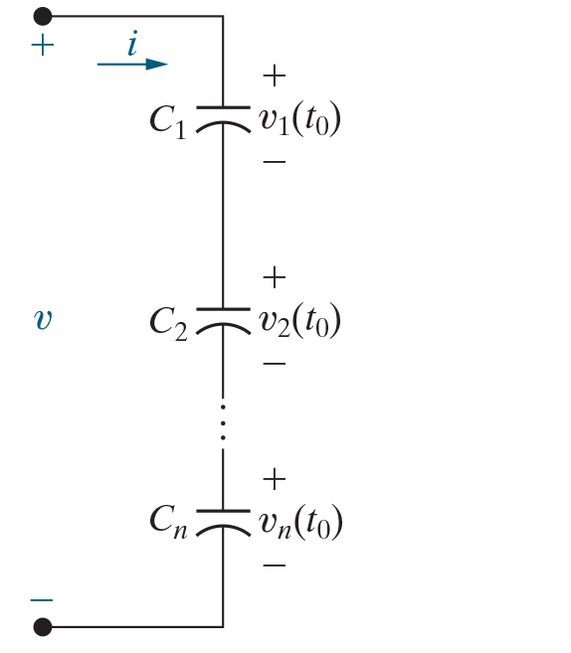
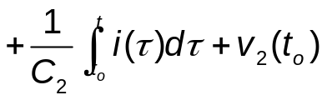
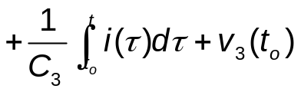
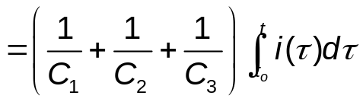

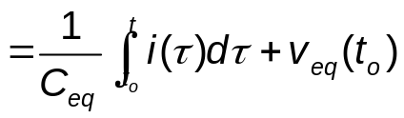
Chapter 6 – Capacitors (15 of 16)
Capacitors in parallel
Capacitors combine in series like resistors or inductors combine in parallel.
Notes:
Long Description 1:
K V L colon v equals v subscript 1 baseline plus v subscript 2 baseline plus v subscript 3 baseline equals Start Fraction 1 over C subscript 1 End Fraction Integral lower limit t subscript 0 upper limit t baseline i (tau) d tau plus v subscript 1 baseline (t subscript 0).
Long Description 2:
equals Open Parenthesis Start Fraction 1 over C subscript 1 End Fraction plus Start Fraction 1 over C subscript 2 End Fraction plus Start Fraction 1 over C subscript 3 End Fraction Close Parenthesis Integral lower limit t subscript 0 upper limit t baseline i (tau) d tau.

Slide 18


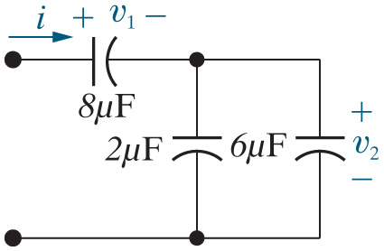



Chapter 6 – Capacitors (16 of 16)
Find the equivalent capacitance for the circuit below,
assuming
and
A.
B.
C.

Slide 19
Chapter 6 – Capacitors (16 of 16)
Find the equivalent capacitance for the circuit below,
assuming
and
A.
B.
C.

Slide 20
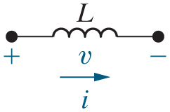
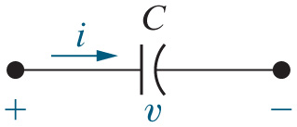
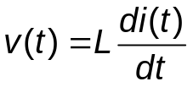

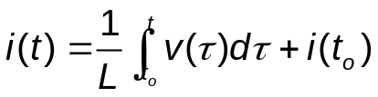
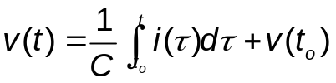



Chapter 6 – Inductance and Capacitance (1 of 2)
Inductor and Capacitor comparison
Blank | Inductor | Capacitor
Symbol
Units | Henries [H] | Farads [F]
Describing equation | v (t) equals L Start Fraction d i (t) over dt End Fraction. | i (t) equals uppercase C Start Fraction d v (t) over d t End Fraction.
Other equation | i (t) equals Start Fraction 1 over L End Fraction Integral lower limit t subscript 0 upper limit t baseline v (tau) d tau plus i (t subscript 0). | v (t) equals Start Fraction 1 over C End Fraction Integral lower limit t subscript 0 upper limit t baseline i (tau) d tau plus v (t subscript 0).
Initial condition | i (t subscript 0). | v (t subscript 0).
Behavior with const. source | If i(t) = I, v(t) = 0 right arrow short circuit | If v(t) = V, i(t) = 0 right arrow open circuit
Continuity requirement | i(t) is continuous so v(t) is finite | v(t) is continuous so i(t) is finite

Slide 21
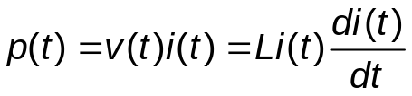
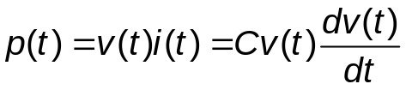






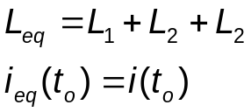
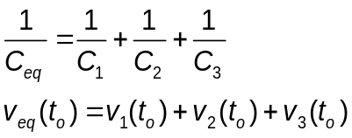
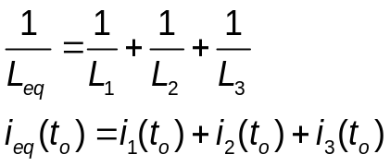
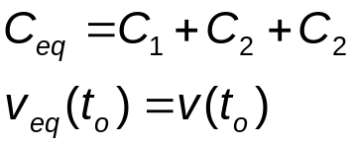
Chapter 6 – Inductance and Capacitance (2 of 2)
Inductor and Capacitor comparison
Blank | Inductor | Capacitor
Power | p (t) equals v (t) i (t) equals L i (t) Start Fraction d i (t) over d t End Fraction. | p (t) equals v (t) i (t) equals C v (t) Start Fraction d v (t) over d t End Fraction.
Energy | w (t) equals Start Fraction 1 over 2 End Fraction L i (t) squared. | w (t) equals Start Fraction 1 over 2 End Fraction C v (t) squared
Initial energy | w subscript 0 baseline (t) equals Start Fraction 1 over 2 End Fraction L i (t subscript 0) squared. | w subscript 0 baseline (t) equals Start Fraction 1 over 2 End Fraction C v (t subscript 0) squared.
Trapped energy | w (infinity) equals Start Fraction 1 over 2 End Fraction L i (infinity) squared. | w (infinity) equals Start Fraction 1 over 2 End Fraction C v (infinity) squared.
Series-connected | Line 1: L subscript e q baseline equals L subscript 1 baseline plus L subscript 2 baseline plus L subscript 2. Line 2: i subscript e q baseline (t subscript 0) equals i (t subscript 0). | Line 1: Start Fraction 1 over C subscript e q End Fraction equals Start Fraction 1 over C subscript 1 End Fraction plus Start Fraction 1 over C subscript 2 End Fraction plus Start Fraction 1 over C subscript 3 End Fraction. Line 2: v subscript e q baseline (t subscript 0) equals v subscript 1 baseline (t subscript 0) plus v subscript 2 baseline (t subscript 0) plus v subscript 3 baseline (t subscript 0).
Parallel-connected | Line 1: Start Fraction 1 over L subscript e q End Fraction equals Start Fraction 1 over L subscript 1 End Fraction plus Start Fraction 1 over L subscript 2 End Fraction plus Start Fraction 1 over L subscript 3 End Fraction. Line 2: i subscript e q baseline (t subscript 0) equals i subscript 1 baseline (t subscript 0) plus i subscript 2 baseline (t subscript 0) plus i subscript 3 baseline (t subscript 0). | The equations are as follows. Line 1: C subscript e q baseline equals C subscript 1 baseline plus C subscript 2 baseline plus C subscript 2. Line 2: v subscript e q baseline (t subscript 0) equals v (t subscript 0).

Slide 22

Copyright
This work is protected by United Kingdom copyright laws and is provided solely for the use of instructors in teaching their courses and assessing student learning. Dissemination or sale of any part of this work (including on the World Wide Web) will destroy the integrity of the work and is not permitted. The work and materials from it should never be made available to students except by instructors using the accompanying text in their classes. All recipients of this work are expected to abide by these restrictions and to honor the intended pedagogical purposes and the needs of other instructors who rely on these materials.

